Slide 1


Initial Public Offering(IPO) Enabler 7151CEM – Computing Individual Research Project Roopesh Vajragiri (13089562) Guided by Daniyal Haider

Slide 2
INTRODUCTION
Background
Firms choose to go public for a variety of reasons, the most common of which is to increase the firm's liquidity and thus raise additional equity capital, a process known as the primary market.
Increasing the firm's capital benefits not only the firm, but also its founders, investors, and other stakeholders.
The four most common reasons are to raise funds, improve the company's image, increase publicity, and use it to motivate employees.
These are not, of course, the only reasons a firm may decide to go public. The decision is personal and is based on the current state of the organization.
Naturally, the interests may be contradictory, because the issuing firm wants to raise as much capital as possible from the floatation, while the investors want to buy the newly issued shares at a low price, and the underwriters act as a middleman who works in the interests of both the issuing firm and the investors (Jenkinson and Ljungqvist, 2001).

Slide 3
INTRODUCTION
Problem Discussion
Two instances that are supposed to occur in all IPOs are the most common and exhaustively discussed in diverse sources.
The first scenario involves equities that are underpriced at the offer price.
The second case is when equities underperform in the long run.
Underpricing is a type of irregular initial return in which a company sells its stock for less than its face value. As a result, between the IPO date and the first-day closing price, the stock price climbs. As a result, it acts as a fundraiser for the listing company.
The long-run underperformance phenomenon shows that IPOs outperform competitors in the same industry and size for three to six years after the IPO.

Slide 4
Relevant Existing Studies
In the United Kingdom, Goergen et al. (2007) discovered poor long-run performance of UK IPOs, particularly those of smaller firms, whereas those of larger enterprises did better in their cross-sectional analysis. This finding is similar with the findings of Burrowes and Jones (2004), who discovered long-run underperformance or negative returns from AIM7 IPOs within the first two years.
Furthermore, Lee et al. (1996) evaluated the short- and long-run returns of 266 Australian IPOs from 1976 to 1989. They also found that the Cumulative Abnormal Return (CAR) was -51.26% at month 36. Furthermore, Lee et al. (1996) claimed that the performance of Australian IPOs was significantly worse than that of US IPOs studied by Ritter (1991).

Slide 5
Overview of the Project
This project will provide a solution to the one of the situations that is discussed in the problem discussion i.e., long run underperformance.
An IPO readiness assessment of a company preparing to go public could uncover unforeseen issues across many areas both inside and outside of the organisation, including:
Capital Market Strategy
Taxation
Finance and Accounting
Corporate Governance/ Legal
Infrastructure
Risk Management
Human Capital

Slide 6
Overview of the Project
IPO Journey
Strategic Considerations & IPO Planning
IPO Preparation
Execution
Being IPO
Strategic Considerations & IPO Planning:
The IPO planning should set the groundwork for a successful IPO. During this period companies will try to identify issues upfront and implement changes to enhance corporate governance and transparency as a public company.
Develop group systems, new functions, and tax optimisation at the corporate and shareholder levels.
Begin constructing capital market infrastructures and/or make structural changes to prepare for an IPO.
Decide which exit strategy will be suitable for the business and shareholders.

Slide 7
Overview of the Project
IPO Journey
Strategic Considerations & IPO Planning
IPO Preparation
Execution
Being IPO
IPO Preparation:
In the preparation phase, the company should be able to provide due diligence support for document requests from underwriters and investors, prepare financial information and other important documentation and manage the filing process.
Prepare presentation materials for banks, analysts, and investors while fine-tuning the business plan and IPO fact book.
Set a goal IPO timeline, begin due diligence, and develop the offering concept.
Based on initial investor input, fine-tune the equity story and valuation approach.

Slide 8
Overview of the Project
IPO Journey
Strategic Considerations & IPO Planning
IPO Preparation
Execution
Being IPO
Execution:
In the final steps of IPO journey to turn company into a public company and be enjoy the associated perks.
Manage the filing process, including finalising the prospectus and obtaining regulatory and stock exchange approvals.
Launch an investor roadshow to attract the right investors in the market's primary pools of money at the right time.

Slide 9
Overview of the Project
IPO Journey
Strategic Considerations & IPO Planning
IPO Preparation
Execution
Being IPO
Being IPO:
As a public firm, keep promises and attract more investor and media attention. Following the IPO, the emphasis should be on careful continuing reporting and disclosure to investors, as well as compliance.

Slide 10

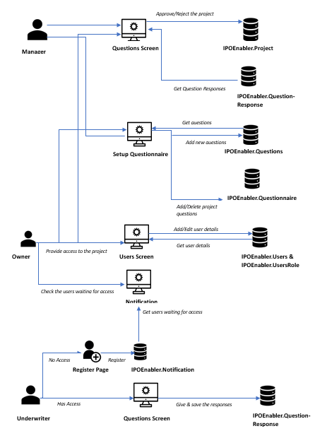
Project Flow

Slide 11
Methodology
The application consist of three user:
Issuing Firm/Owner
Underwriters
Managers
Issuing Firm/Owner: Owner will be able to perform all the operations like create/edit/delete. In the IPO consideration stage, the owner will be adding the questions based on the functional areas.
Underwriters: Underwriters will have the access only to the questions page where they need to give the responses to the questions added by the owner. And also, they giving the effort and impact responses for each question.
Managers: Once the underwriters give the responses and click on submit. In the IPO preparation stage, the managers will review those responses, and application will generate a report. Based on the report generated on the application, company will decide whether they are good in that functional area or they have to improve in that functional area.

Slide 12
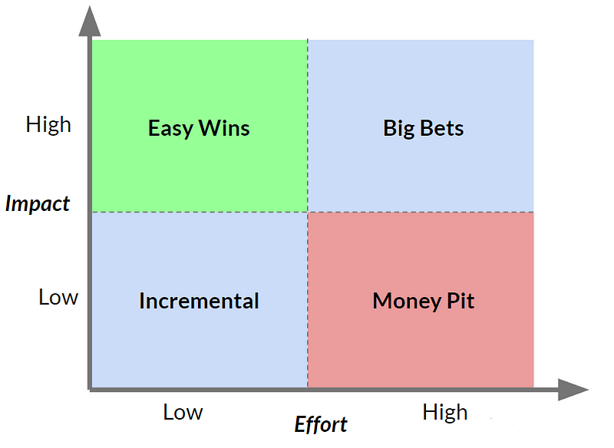
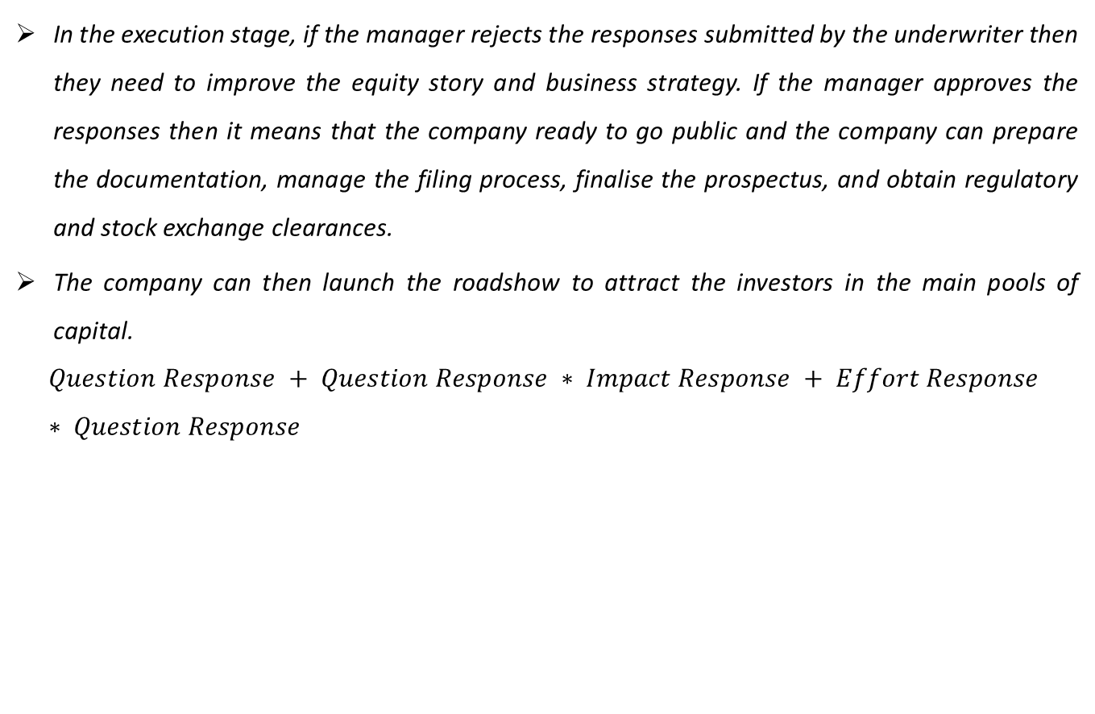
Methodology
In the execution stage, if the manager rejects the responses submitted by the underwriter then they need to improve the equity story and business strategy. If the manager approves the responses then it means that the company ready to go public and the company can prepare the documentation, manage the filing process, finalise the prospectus, and obtain regulatory and stock exchange clearances.
The company can then launch the roadshow to attract the investors in the main pools of capital.
$$Question Response + Question Response ∗ Impact Response + Effort Response ∗ Question Response$$

Slide 13
Pros & Cons of IPO Enabler
Pros
Cons
Access to capital markets that is efficient for generating cash through share and bond offerings, with better future financing prospects.
The capacity to trade stocks on a daily basis with great liquidity.
Customers and suppliers attention, brand awareness, and status have all increased.
The ability to compare operations to other publicly traded companies in the same industry.
On the shareholder side, there is the potential for wealth diversification.
More transparency and disclosure requirements.
New shareholders with voting rights.
Having a smaller share in the company.

Slide 14
Result
The application will generate a report. And report consist of the questions and responses.
The functional areas for that company added by the owner.
Response for the functional areas in which the company is very low, low, medium, high and very high.
The existing studies focus on both the situation i.e., under-pricing and underperformance. Those studies will applicable only for some industries and some functional areas.
This application will focus on underperformance and it is applicable for all kind of industries and all the functional areas.

Slide 15
Conclusion
A complicated and dynamic process, the initial public offering process presents opportunities and difficulties for businesses, investors, financial institutions, regulators, and researchers. Stakeholders may maximize the benefits, taking into account the needs and expectations of various stakeholders, and utilizing best practices, eventually resulting in robust and vibrant capital markets.

Slide 16
References
Burrowes and Jones (2004)., 2004, Re-Assessing the long-Term underperformance of UK Initial Public Offerings, European Financial Management, 6, 319- 342.
Goergen, M., Khurshed, A., Mudambi, R., 2007, The long-run performance of UK IPOs: Can it be predicted? Managerial Finance, 33, 401-419.
Lee et al. (1996), Why do issuers not get upset about leaving money on the Table in IPOs?, Review of Financial Studies, 15, 413-443.
Ljungqvist, A., Jenkinson, T & Wilhelm, W. (2003) Review of financial studies. Global integration in primary equity markets: The role of U.S. banks and U.S. investors, vol 16, p. 63-99.
Ritter, J.R., 1991, The long-run performance of Initial Public Offerings, Journal of Finance, 46, 3-27.

Slide 17


Slide 18
Thank
You

